Slide 1
EXCEPTION HANDLING IN JAVA
Prepared By: Dimple Bohra

Slide 2
Exception handling
The Exception Handling in Java is one of the powerful mechanism to handle the runtime errors so that normal flow of the application can be maintained.

Slide 3
What is an exception ?
Dictionary Meaning: Exception is an abnormal condition.
An exception (or exceptional event) is a problem that arises during the execution of a program.
When an Exception occurs the normal flow of the program is disrupted and the program/Application terminates abnormally, which is not recommended, therefore, these exceptions are to be handled.

Slide 4
What is an exception handling ?
Exception Handling is a mechanism to handle runtime errors such as:
ClassNotFoundException,
IOException,
SQLException,
RemoteException, etc.

Slide 5
Hierarchy of java exception classes
The java.lang.Throwable class is the root class of Java Exception hierarchy which is inherited by two subclasses:
-> Exception and Error.

Slide 6
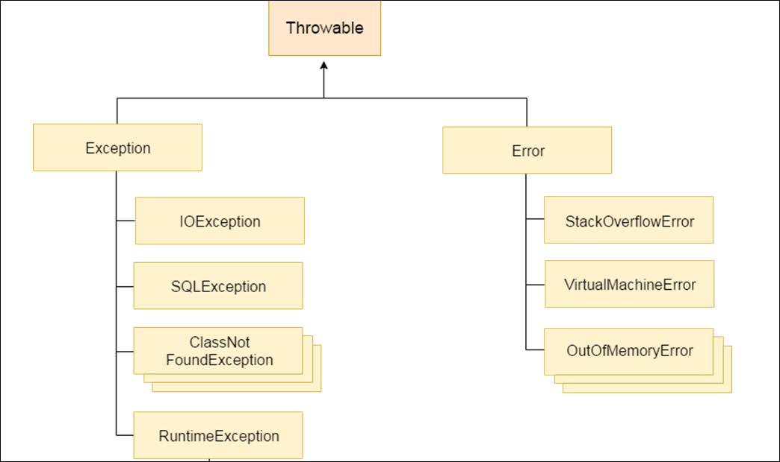
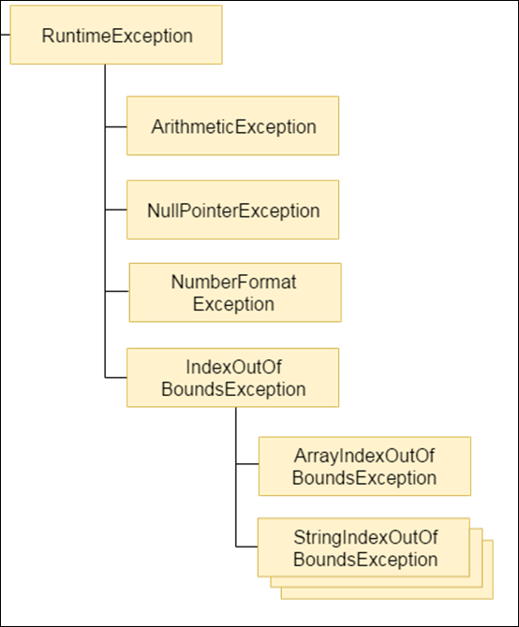

Slide 7
Types of java exceptions
There are mainly two types of exceptions: checked and unchecked.
Here, an error is considered as the unchecked exception.
According to Oracle, there are three types of exceptions:
Checked Exception
Unchecked Exception
Error

Slide 8
Difference between checked and unchecked
1) Checked Exception
The classes which directly inherit Throwable class except RuntimeException and Error are known as checked exceptions e.g. IOException, SQLException etc. Checked exceptions are checked at compile-time.
2) Unchecked Exception
The classes which inherit RuntimeException are known as unchecked exceptions e.g. ArithmeticException, NullPointerException, ArrayIndexOutOfBoundsException etc. Unchecked exceptions are not checked at compile-time, but they are checked at runtime.
3) Error
Error is irrecoverable e.g. OutOfMemoryError, VirtualMachineError, AssertionError etc.

Slide 9
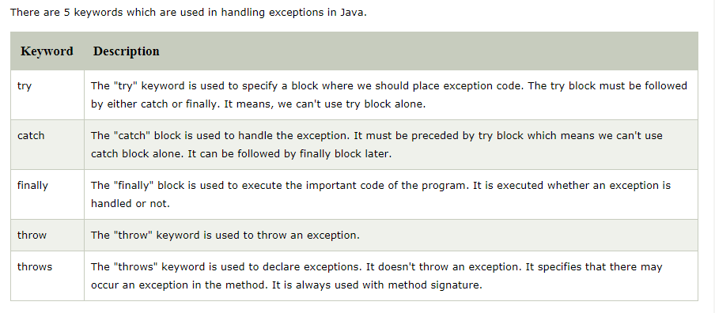
Java exception keywords

Slide 10
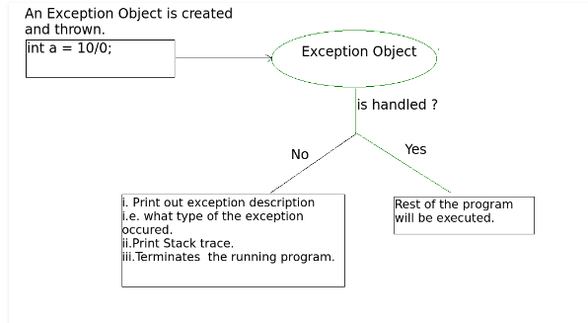
Exception handling concept

Slide 11
Java try-catch block
Java try block
Java try block is used to enclose the code that might throw an exception. It must be used within the method.
If an exception occurs at the particular statement of try block, the rest of the block code will not execute.
So, it is recommended not to keep the code in try block that will not throw an exception.
Java try block must be followed by either catch or finally block.

Slide 12
Syntax of try-catch
Syntax of try-finally
try
{
//code that may throw an exception
}
catch(Exception_class_Name ref)
{
//exception handling code
}
try
{
//code that may throw an exception
}
Finally
{
}

Slide 13
Java try-catch block
Java catch block
Java catch block is used to handle the Exception by declaring the type of exception within the parameter.
The declared exception must be the parent class exception ( i.e., Exception) or the generated exception type.
However, the good approach is to declare the generated type of exception.
The catch block must be used after the try block only. You can use multiple catch block with a single try block.

Slide 14
Java try-catch block
Java finally block
Java finally block is a block that is used to execute important code such as closing connection, stream etc.
Java finally block is always executed whether exception is handled or not.
Java finally block follows try or catch block.

Slide 15
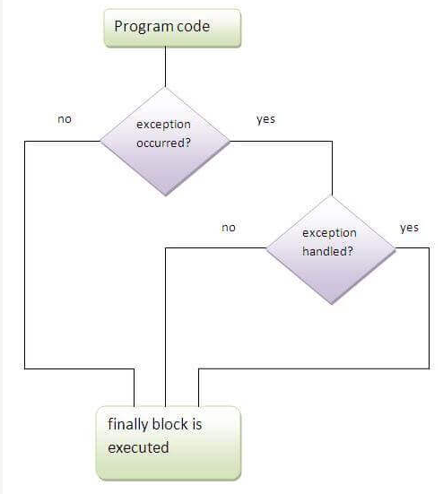
Flowchart of finally block execution

Slide 16
Why use java finally
Finally block in java can be used to put "cleanup" code such as closing a file, closing connection etc.

Slide 17
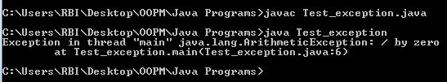
Example without exception handling
public class Test_exception
{
public static void main(String args[])
{
int data=100/0;
System.out.println("rest of the code...");
}
}

Slide 18
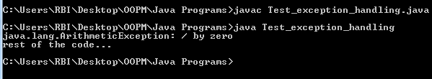
Example With try-catch block
public class Test_exception_handling
{
public static void main(String args[])
{
try
{
//code that may raise exception
int data=100/0;
}
catch(ArithmeticException e)
{
System.out.println(e);
}
//rest code of the program
System.out.println("rest of the code...");
}
}

Slide 19
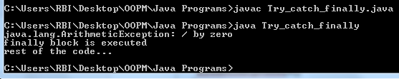
Example with try-catch-finally block
public class Try_catch_finally
{
public static void main(String args[])
{
try
{
int data=100/0;
}
catch(ArithmeticException e)
{
System.out.println(e);
}
finally
{
System.out.println("finally block is executed");
}
System.out.println("rest of the code...");
}
}

Slide 20
Common scenarios of java exceptions
1) A scenario where ArithmeticException occurs
If we divide any number by zero, there occurs an ArithmeticException.
int a=50/0;//ArithmeticException
2) A scenario where NullPointerException occurs
If we have a null value in any variable, performing any operation on the variable throws a NullPointerException.
String s=null;
System.out.println(s.length());//NullPointerException
Notes:
There are given some scenarios where unchecked exceptions may occur. They are as above

Slide 21
Common scenarios of java exceptions
3) A scenario where NumberFormatException occurs
The wrong formatting of any value may occur NumberFormatException. Suppose I have a string variable that has characters, converting this variable into digit will occur NumberFormatException.
String s="abc";
int i=Integer.parseInt(s);//NumberFormatException

Slide 22
Common scenarios of java exceptions
4) A scenario where ArrayIndexOutOfBoundsException occurs
If you are inserting any value in the wrong index, it would result in ArrayIndexOutOfBoundsException as shown below:
int a[]=new int[5];
a[10]=50; //ArrayIndexOutOfBoundsException

Slide 23
Common scenarios of java exceptions
5) A scenario where StringIndexOutOfBoundsException occurs
String str="OOPM";
System.out.println(str.length());;
char c = str.charAt(5);

Slide 24
Java multi catch block
A try block can be followed by one or more catch blocks.
Each catch block must contain a different exception handler.
So, if you have to perform different tasks at the occurrence of different exceptions, use java multi-catch block.

Slide 25
Points to remember about multi catch block
At a time only one exception occurs and at a time only one catch block is executed.
All catch blocks must be ordered from most specific to most general, i.e. catch for ArithmeticException must come before catch for Exception.

Slide 26
Example 1 of multi catch block
public class MultipleCatchBlock {
public static void main(String[] args) {
try{
int a[]=new int[5];
a[5]=30/0;
}
catch(ArithmeticException e)
{
System.out.println("Arithmetic Exception occurs");
}
catch(ArrayIndexOutOfBoundsException e)
{
System.out.println("ArrayIndexOutOfBounds Exception occurs");
}
catch(Exception e)
{
System.out.println("Parent Exception occurs");
}
System.out.println("rest of the code");
}
}

Slide 27

Example 1 of multi catch block
catch(Exception e)
{
System.out.println("Parent Exception occurs");
}
System.out.println("rest of the code");
}
}
public class MultipleCatchBlock {
public static void main(String[] args) {
try{
int a[]=new int[5];
a[5]=30/0;
}
catch(ArithmeticException e)
{
System.out.println("Arithmetic Exception occurs");
}
catch(ArrayIndexOutOfBoundsException e)
{
System.out.println("ArrayIndexOutOfBounds Exception occurs");
}

Slide 28
Example 2 of multi catch block
catch(ArrayIndexOutOfBoundsException e)
{
System.out.println("ArrayIndexOutOfBounds Exception occurs");
}
catch(Exception e)
{
System.out.println("Parent Exception occurs");
}
System.out.println("rest of the code");
}
}
public class MultipleCatchBlock2{
public static void main(String[] args) {
try{
int a[]=new int[5];
System.out.println(a[10]);
}
catch(ArithmeticException e)
{
System.out.println("Arithmetic Exception occurs");
}

Slide 29

Example 2 of multi catch block
catch(ArrayIndexOutOfBoundsException e)
{
System.out.println("ArrayIndexOutOfBounds Exception occurs");
}
catch(Exception e)
{
System.out.println("Parent Exception occurs");
}
System.out.println("rest of the code");
}
}
public class MultipleCatchBlock2{
public static void main(String[] args) {
try{
int a[]=new int[5];
System.out.println(a[10]);
}
catch(ArithmeticException e)
{
System.out.println("Arithmetic Exception occurs");
}

Slide 30
Example 3 of multi catch block
catch(ArrayIndexOutOfBoundsException e)
{
System.out.println("ArrayIndexOutOfBounds Exception occurs");
}
catch(Exception e)
{
System.out.println("Parent Exception occurs");
}
System.out.println("rest of the code");
}
}
public class MultipleCatchBlock3 {
public static void main(String[] args) {
try{
int a[]=new int[5];
a[5]=30/0; //arithmeticexception
System.out.println(a[10]);//arrayindexoutofbound
}
catch(ArithmeticException e)
{
System.out.println("Arithmetic Exception occurs");
}
Notes:
In this example, try block contains two exceptions. But at a time only one exception occurs and its corresponding catch block is invoked.

Slide 31

Example 3 of multi catch block
catch(ArrayIndexOutOfBoundsException e)
{
System.out.println("ArrayIndexOutOfBounds Exception occurs");
}
catch(Exception e)
{
System.out.println("Parent Exception occurs");
}
System.out.println("rest of the code");
}
}
public class MultipleCatchBlock3 {
public static void main(String[] args) {
try{
int a[]=new int[5];
a[5]=30/0; //arithmeticexception
System.out.println(a[10]);//arrayindexoutofbound
}
catch(ArithmeticException e)
{
System.out.println("Arithmetic Exception occurs");
}

Slide 32
Solution to example 3
try
{
System.out.println(a[10]);
}
catch(ArrayIndexOutOfBoundsException e)
{
System.out.println("ArrayIndexOutOfBounds Exception occurs");
}
catch(Exception e)
{
System.out.println("Parent Exception occurs");
}
System.out.println("rest of the code");
}
}
public class MultipleTryCatch
{
public static void main(String[] args)
{
int a[]=new int[5];
try
{
a[5]=30/0;
}
catch(ArithmeticException e)
{
System.out.println("Arithmetic Exception occurs");
}

Slide 33
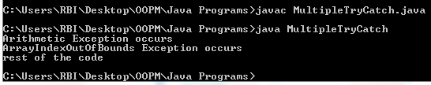
Solution to example 3
try
{
System.out.println(a[10]);
}
catch(ArrayIndexOutOfBoundsException e)
{
System.out.println("ArrayIndexOutOfBounds Exception occurs");
}
catch(Exception e)
{
System.out.println("Parent Exception occurs");
}
System.out.println("rest of the code");
}
}
public class MultipleTryCatch
{
public static void main(String[] args)
{
int a[]=new int[5];
try
{
a[5]=30/0;
}
catch(ArithmeticException e)
{
System.out.println("Arithmetic Exception occurs");
}

Slide 34
Example 4 of multi catch block
public class MultipleCatchBlock4 {
public static void main(String[] args) {
try{
String s=null;
System.out.println(s.length());
}
catch(ArithmeticException e)
{
System.out.println("Arithmetic Exception occurs");
}
catch(ArrayIndexOutOfBoundsException e)
{
System.out.println("ArrayIndexOutOfBounds Exception occurs");
}
catch(Exception e)
{
System.out.println("Parent Exception occurs");
}
System.out.println("rest of the code");
}
}
Notes:
In this example, we generate NullPointerException, but didn't provide the corresponding exception type. In such case, the catch block containing the parent exception class Exception will invoked.

Slide 35

Example 4 of multi catch block
public class MultipleCatchBlock4 {
public static void main(String[] args) {
try{
String s=null;
System.out.println(s.length());
}
catch(ArithmeticException e)
{
System.out.println("Arithmetic Exception occurs");
}
catch(ArrayIndexOutOfBoundsException e)
{
System.out.println("ArrayIndexOutOfBounds Exception occurs");
}
catch(Exception e)
{
System.out.println("Parent Exception occurs");
}
System.out.println("rest of the code");
}
}

Slide 36
Java nested try block
The try block within a try block is known as nested try block in java.
Sometimes a situation may arise where a part of a block may cause one error and the entire block itself may cause another error. In such cases, exception handlers have to be nested.

Slide 37
Example of nested try
try
{
System.out.println(a[10]);
}
catch(ArrayIndexOutOfBoundsException e)
{
System.out.println("ArrayIndexOutOfBounds Exception occurs");
}
}
catch(Exception e)
{
System.out.println("Parent Exception occurs");
}
System.out.println("rest of the code");
}
}
public class NestedTry
{
public static void main(String[] args)
{
int a[]=new int[5];
try
{
try
{
a[5]=30/0;
}
catch(ArithmeticException e)
{
System.out.println("Arithmetic Exception occurs");
}

Slide 38

Example of nested try
try
{
System.out.println(a[10]);
}
catch(ArrayIndexOutOfBoundsException e)
{
System.out.println("ArrayIndexOutOfBounds Exception occurs");
}
}
catch(Exception e)
{
System.out.println("Parent Exception occurs");
}
System.out.println("rest of the code");
}
}
public class NestedTry
{
public static void main(String[] args)
{
int a[]=new int[5];
try
{
try
{
a[5]=30/0;
}
catch(ArithmeticException e)
{
System.out.println("Arithmetic Exception occurs");
}

Slide 39
Java program to handle many exceptions with single try-catch block
try
{
switch (i)
{
case 0 :
int zero = 0;
j = 92/ zero;
break;
case 1 :
int b[ ] = null;
j = b[0] ;
break;
default:
System.out.print("No exception");
}
}
catch(Exception e)
{
//System.out.println(e.getMessage());
// e.printStackTrace();
//System.out.println(e);
System.out.print(e.toString());
}}}
import java.util.*;
public class SingleTryCatch
{
public static void main (String args[ ] )
{
Scanner scan = new Scanner(System.in);
int i = scan.nextInt();
int j;

Slide 40
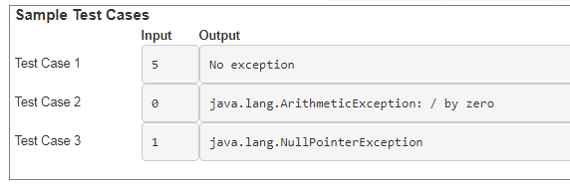
Expected output of Nptel assignment

Slide 41
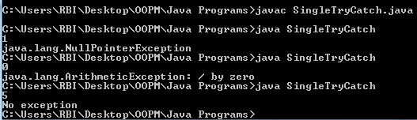
Java program to handle many exceptions with single try-catch block
try
{
switch (i)
{
case 0 :
int zero = 0;
j = 92/ zero;
break;
case 1 :
int b[ ] = null;
j = b[0] ;
break;
default:
System.out.print("No exception");
}
}
catch(Exception e)
{
//System.out.println(e.getMessage());
// e.printStackTrace();
//System.out.println(e);
System.out.print(e.toString()); }}}
import java.util.*;
public class SingleTryCatch
{
public static void main (String args[ ] )
{
Scanner scan = new Scanner(System.in);
int i = scan.nextInt();
int j;

Slide 42

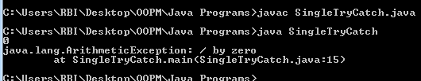
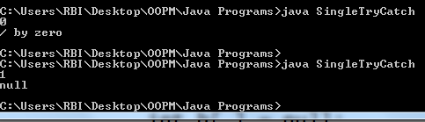
Ways to print handled exceptions
System.out.println(e);
e.printStackTrace();
System.out.println(e.getMessage());

Slide 43
User defined / custom exceptions
In java we have already defined, exception classes such as ArithmeticException, NullPointerException etc.
These exceptions are already set to trigger on pre-defined conditions such as when you divide a number by zero it triggers ArithmeticException.
In java we can create our own exception class and throw that exception using throw keyword.
These exceptions are known as user-defined or custom exceptions.

Slide 44
class MyException extends Exception
{
String s1;
MyException(String s2)
{
s1=s2;
}
public String toString()
{
return("user defined exception:"+s1);
}
}
public class Main
{
public static void main(String args[])
{
try
{
throw new MyException("my exception");
}
catch(MyException e)
{
System.out.println(e);
System.out.println(e.toString());
}
}

Slide 45

public class Main
{
public static void main(String args[])
{
try
{
throw new MyException("my exception");
}
catch(MyException e)
{
System.out.println(e);
System.out.println(e.toString());
}
}
class MyException extends Exception
{
String s1;
MyException(String s2)
{
s1=s2;
}
public String toString()
{
return("user defined exception:"+s1);
}
}

